Slide 1
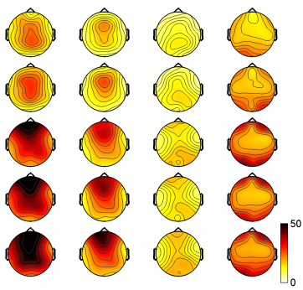
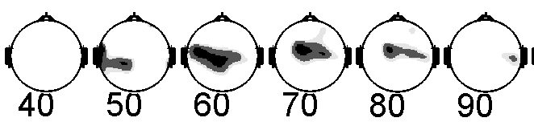

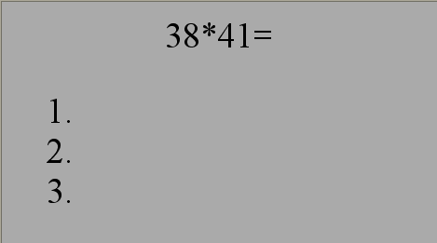
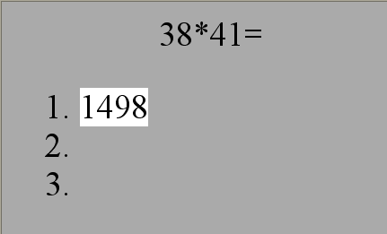
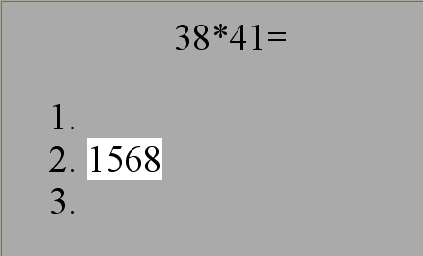
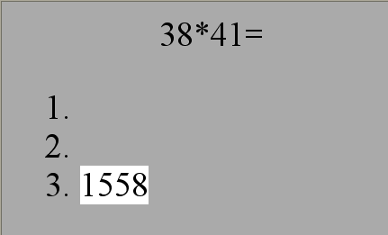


Dynamics of cognitive tension level during mental arithmetical operations



Sherbina D.N.
Southern federal university. Rostov-on-Don. Russia. sherdim@mail.ru
Introduction

Brain activation by CT level

Attentional resources are restricted (Engle et al., 1999; Rohrer, Pashler, 2003). But operator is not in top tension all the time – cognitive tension (CT) is spread in a specific timely fashion. What factors accounts for the time pattern of low and high CT?
Dual-task approach allowed to estimate momentary cognitive tension level every 2 sec with minimal impact on the primary activity efficacy.
EEG spectral density maps
ERP waveforms
ease
SMR
CT1
CT2
CT3
μV
SAMR
Stimul
CT1
CT2
CT3
s
Grand-averaged ERP recorded form Fz. Ox – time from sound stimulus onset, s.
μV²
CNV distribution in control SMR vs. ANOVA difference of CT1 & CT3
Method
δ θ α β

A
B
Dual-task paradigm
EEG recorded form 21 references by 10-20 system. To the left – states: ease – passive state with open eyes, SMR – audial-motor reaction only; CT1-3 – dual-task, classified by cognitive load. To the bottom – frequency bands: δ – 2-4 Hz, θ – 4-8 Hz, α – 8-13 Hz, β – 13-25 Hz.
A – ERP potential map in the moment of stimulus onset, negativity in red.
B – confident level for the difference between ERP waveforms in states of CT1 and CT3.
Numbers under maps - time from stimulus onset in ms.
?
mental arithmetic
Individual data
CT1. Predominant SMR execution. A subject is distracted from MA, attended on ongoing sound clicks. Mind is loaded with the next sound onset prediction. RT is close to usual values 0.15-0.25 s.

task perseption
calculation operations
answer choice
t
Total time of being in the states with different levels of CT
sensory-motor reaction
CT2. Partial execution of SMR and MA. The attention is distributed between two activities, so arithmetic load is not much. RT is longer, but still linked to the stimulus, - 0.25-1 s.
s
- sound click 1 ms, 100 dB
1.6-2.4 s
- mouse button press with left hand
CT3. Predominant concentration on MA. A subject is fully distracted from SMR. RT exceeds 1 s or no reaction at all.
RT distribution
Dynamics of CT
Ox – individuals marked with initials, Oy – time of being in the experiment.
Dark bars – high CT3, gray bars – middle CT2, white bars – low CT1. Dashed bars – non-stable spans, which were mixes of CT1, CT2 & CT3, whose shares are divided with horizontal dashed lines. Arrows above – subjects with poor overall performance < 50%.
Decision time of one problem varied from 12.7±1.5 s to 91.4±18.6 s (mean - 43.6±1.1 s).

Ox – RT, s, Oy – a share of RT values for a bin. Bin width is 0.025 s.
s
Quick decision of a middle problem
Calculation of cognitive tension
Discussion

Heavy decision of a complex problem
The analysis of activation changes due to CT level revealed that the deeper mental processes were accompanied with the increase of oscillatory activity in theta and alpha ranges at frontal and central cortical regions. Theta activity increase at central regions may be accounted of decision making (Jacobs, Hwang, Curran, Kahana, 2006), and theta activity of 6-7 Hz and its harmonic of 14 Hz at the anterior frontal regions – memory processes (Onton, Delorme, Makeig, 2005; Sauseng, Hoppe, Klimesch, Gerloff, Hummel, 2007; Pesonen, Hämäläinen, Krause, 2007). Similar activation pattern during complex verbal workload was shown also (Razumnikova, 2007).
The pattern of distribution of being in the states of high and middle CT characterizes the task complexity more precisely as compared to the standard metric - the overall time spent to solve a problem.
Tough decision
Sometimes when cognitive load gets bigger than residual motivation, CT pattern changes and the following states can be diagnosed.
Approximate decision (potentially erroneous)
Poor concentration (error rate > 0.3)
Ox – time from task onset, s., Oy – RT, s. Color corresponds CT level: green – CT1, yellow – CT2, red – CT3. Numbers above mark presentations of answer variants , red numbers correspond false answers.
References
1. Айдаркин Е.К., Огарев М.И, Покуль С.Ю, Щербина Д.Н., Айдаркина Е.С. Разработка методов контроля текущего состояния обучающегося в динамике решения арифметических задач // Валеология, 2006, № 4, стр. 69-77.
2. Айдаркин Е.К., Щербина Д.Н, Богун А.С. Соотношение общей и локальной активации мозга при различном уровне когнитивного напряжения во время умножения двузначных чисел // Валеология, 2008. № 1 (в печати).
t_{Uj} – time of the decision end, s, t_{i} - time of the beginning of key press, t_{Ri} – time of the beginning of key press, s, LP_{i} – latent period of SMR, s; T_{k} – time of being in the state of k, s .

